Slide 1
The egg legend
Made by Gabriela Palasz class 1a

Slide 2
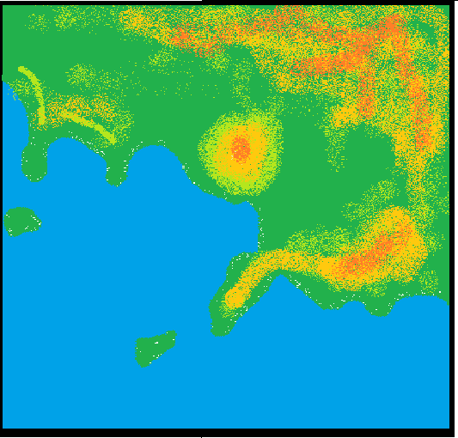
Topographic map of the Gulf of
This is the Gulf of Naples in Itally

Slide 3
And this is the Egg Castle.

Slide 8
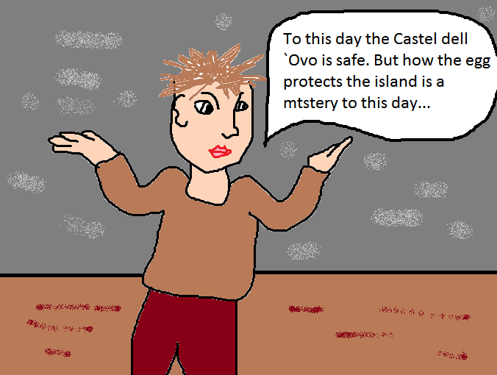

Slide 9
The End

